Slide 1




Low-Cost Precipitation Phase Partitioning Using Acoustic Data and Machine Learning in the Edge
Christian Skalka, Rachael Chertok, Julia Sober, Soheyl Faghir-Hagh, Tian Xia
Notes:
Takeaways from this presentation: we present a low cost, novel way of precipitation phase partitioning in alpine environments, which can also be used for rain on snow detection.

Slide 2
Precipitation Phase Partitioning with IoT Sytems
Precipitation phase partitioning: an important, difficult problem for alpine snow hydrology.
E.g., Rain on snow detection: one of the 23 unsolved problems in hydrology [1]
Our goal: how to detect rain vs. hail vs. snow with ground-based sensors?
Existing sensors (e.g., disdrometers) are expensive and power-hungry.
Poor spatial resolution- but high spatial variability of phase in alpine settings.
Our approach: Low-cost AI enabled IoT systems, using acoustic sensors.
Modern platforms (e.g., Arduino) highly programmable, low power/cost.
Low cost/power/size = better spatial resolution.
[1] Gunter Bloschl, Marc FP Bierkens, Antonio Chambel, Christophe Cudennec, Georgia Destouni, Aldo Fiori, James WKirchner, Jeffrey J McDonnell, Hubert HG Savenije, Murugesu Sivapalan, et al. Twenty-three unsolved problems in hydrology–a community perspective. Hydrological sciences journal, 64(10):1141–1158, 2019
Notes:
Precip phase partitioning is an important and difficult problem in alpine snow hydrology. We need precip phase partitioning to do ROS detection, which is important b/c it’s an unsolved problem in hydrology. Our method is to dtect rain vs hail vs snow with ground-based sensors.
For example, being able to perform precipitation phase partitioning allows us to also perform rain on snow detection, which is labeled as one of the 23 unsolved problems in hydrology

Slide 3
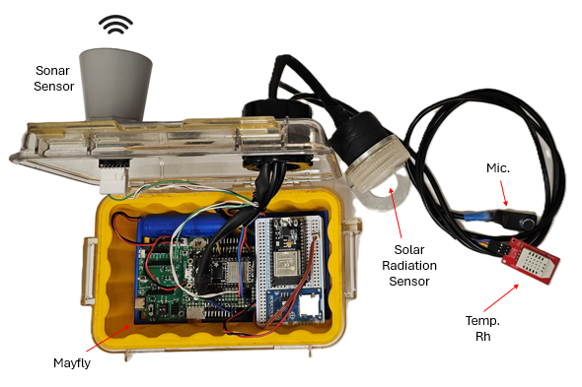
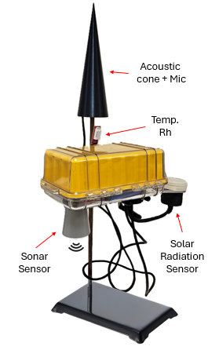
Low-Cost Arduino Sensor Platform
Precipitation phase detection, summary:
Audio data recorded via a microphone.
Audio features extracted from this audio via signal processing.
Features provided to ML models, previously trained to classify precipitation phase.
Critical to embed the entire prediction workflow on device.
Streaming sound data is too costly for remote near-real-time reporting or even storage.
Smart sampling ensures conservative use of mic.
Phase partitioning can be integrated into a complete snow sensor system (incl. snow depth, temp/rh, others).
Notes:
Here are some photo of our prototype device. Audio data is recorded with a microphone underneath the conical resonation chamber, built at a very steep angle to reduce snow loading. Mic is connected to Arduino device (point to top photo), this is where the audio features are extracted to and sgnal processing is performed, … Groumd based sensor systems don’t have the bandwidth or power supply to support 24/7 streaming audio data.. Prediction needs to be done on device so that you only need to communicate the classification itself, which is low bandwidth. We can also implement a smart sampling method into algorithm to reduce power usage. Streaming sound data is too costly to ___ via satellite from remote locations. You have low power devices, can’t sustain high bandwidth comms. Last point is more of a side point. (Incidentally, this workflow can also be incorporated with other sensors into a full snow sensing system -> point to device_ (if someone asks about solar radiation sensor, say that was used in a previous project for leaf area index (LAI)-relevant to ablation and accumulation of snow).
Note: Power and memory usage: Max ~30mA during prediction workflow, 16KB RAM. \
Feathers are our LoRa module, connected with I2C
Plan is to keep everything open source. (HW and SW)
$350-400 total cost for everything in the photo

Slide 4
Detection Algorithm Flowchart
If dew point > 100 - ε
No: Wait x minutes, then resample
Yes
Microphone
Time series sound data (.wav file)
Fast Fourier Transform (FFT / STFT)
Extract time domain features
Extract frequency domain (spectrogram) features
Use as input features to ML models
Outputs: Classified precipitation phase
Light rain, heavy rain, light hail, heavy hail, snow, silence
Notes:
Emphasize that this is a flowchart to describe our algorithm. This flowchart describes the program logic/workflow of our algorithm. At the top, describes our smart sampling regime. Make a stronger connection – describes the algorithm of our workflow on device
Mic produces a waveform. As is typically the case for audio data, that waveform is split into time and frequency domains of the sound. The wav file is itself in time domain. We extract time domain features directly from the .wav file. We can do an FFT to extract freq . Do 2 types of STFT (that’s why MFCCs are
*A flowchart that describes our detection algorithm

Slide 5
Machine Learning Technologies
Models must be able to fit on embedded device (both for storage and processing).
Rules out deep learning architectures.
Algorithms we’ve evaluated:
Random Forests
Support Vector Machines (SVM)
XGBoost (ruled out, too computationally expensive)
Logistic Regression (too simple for this data, did not converge)
Signal processing performed to extract audio features:
Time domain: four candidate temporal features.
Frequency domain:
From FFT: 12 candidate spectral features.
From STFT: Candidate 13 Mel Frequency Cepstral Coefficients (MFCCs).
Grid search and other feature selection methods to evaluate candidate features.
Notes:
Models need to fit on embedded devices which – nonvolatile memory – if you turn machine off, stuff won’t be there. RAM is volatile (things will still be on device after it’s turned off), Flash is volatile, disk is nonvolatile.
Program can’t be too big to fit on the nonvolatile memory on the machine. You need to have enough RAM. Rules out DL architectures because they’re massive models.
Last bulletpoint is where you can say, MFCCs are a more direct representation of the time series spectrogram, which is why they’re more computationally expensive. Representation of short term power spectrum of a sound, used in many sound classification tasks. Has the benefit that it’s a more complete representation of the original frequency spectrum, but it is more computationally expensive. Less information loss. The algos we evaluated are known to have smaller footprints and are known effective methods. There other algos have been shown to be effective in previous works and have smaller footprints. LR not converging shows that it’s a nonlinear problem. We identified candidates based on previous work, as well as what could be realistically implemented on device.
*When talking about features, mention an example of one temporal and one spectral feature

Slide 6
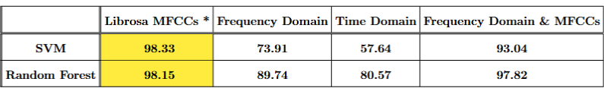
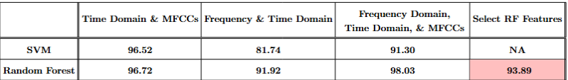
Machine Learning Results with Simulated Data
Input features to ML models retrieved from simulated and real data, using our recording device setup.
*Not yet implemented on device
Notes:
Dataset constructed from simulated and some real data. We simulate using a watering can for rain and couscous for hail, we also have some real rain, and real snow. Computationally expensive to compute MFCCs. If asked: explain that we need to do an STFT to extract MFCCs instead of just an STFT, instead of just an FFT. Then, there are other steps to extract an MFCCs. We’ve found that the major blocking point is the STFT.
Here’s our results. Want to focus on our highlighted results because those are the best results. Yellow is most accurate. We haven’t been able to get full modeling workflow with yellow on device and it’s most computationally expensive because we’re computing MFCCs. Pink highlighted is the best accuracy we’re getting.
The results I want to focus on here are the best results using MFCCs, and the best results not using MFCCs. Both are good, even though the MFCCs are over 98%, it would still be valuable to possibly not use MFCCs due to the computational overhead involved. [Still working on getting the full workflow with MFCCs working on device.]
MFCCs do provide the best accuracy, but require a lot of power. By using features that do not require an STFT, and therefore consume less power, we are able to still achieve almost a 94% accuracy, with much less power.

Slide 7
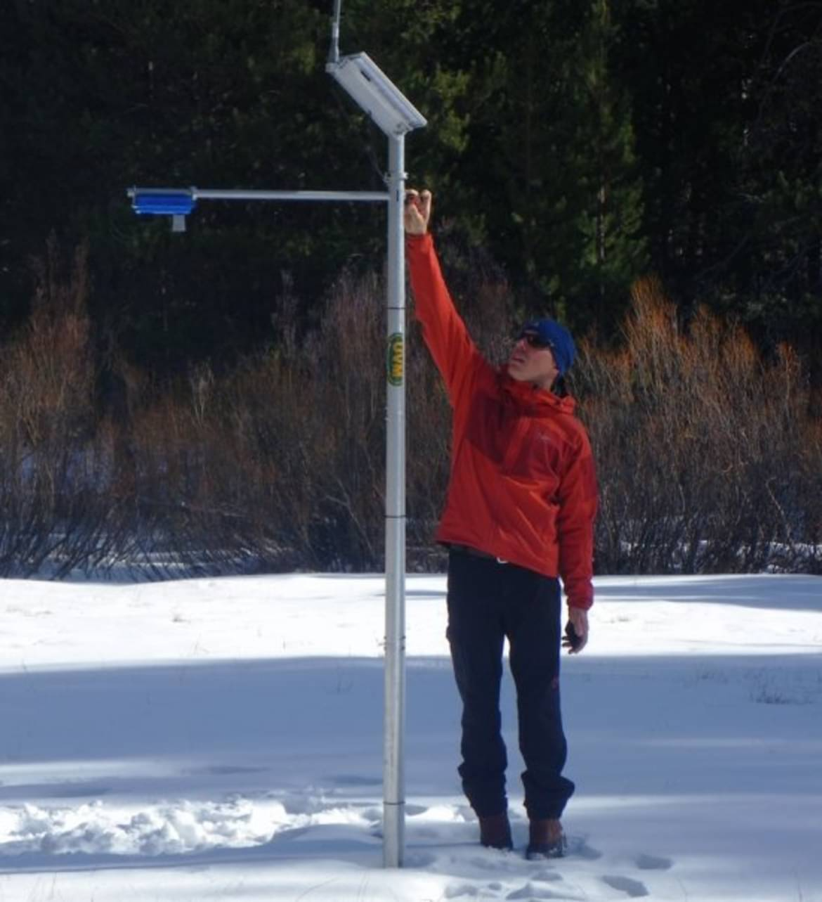
Current and Future Work
Collecting real weather audio (in process)
Refining models using real data
Refining hardware for remote IoT-based sensor network deployments.
Local area networking via LoRA.
Near real time reporting via satellite uplink.
Integration with full snow hydrology sensor suite:
Snow depth, soil moisture, temp/RH.
Thanks to our project team at UVM, the CIROH Consortium, NOAA and USGS
Notes:
Device will be connected to a Raspberry Pi, which has wifi (as opposed to putting wifi on the device or moving the microphone setup to a raspberry pi). Pi is used as wifi and the things that we send the results to. Write .wav file to Rpi, from Rpi can copy the data over the Internet to Silk server.
Validate on real data.
Eventually, aim to produce at moderate scale, for specific scale for field studies in snow hydrology, but pending funding approval
Eventually in 2 deployments of 5. Hub and spoke (star network) design, one connected to sat has most power
Immediate next step is to refine our prototype
Refine HW, produce at moderate scale (budget is for 10 of these), and use in real snow hydrology settings.
2 separate deployments of 5-one in CO, one in VT

Slide 8
Supplemental Slides

Slide 9

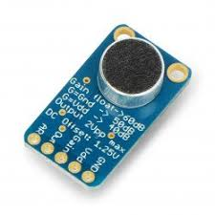

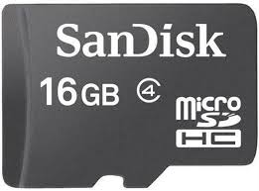

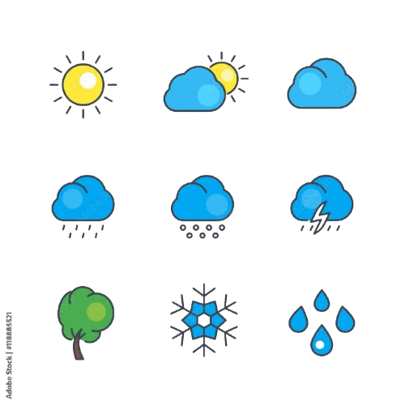
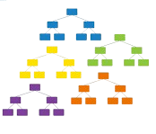
MFCC Extraction Flow Chart
Microphone
Record .wav files onto the SD card
ADC
Pin A0
Read the .wav file from SD
Apply Windowing
Calculate and Save MFCCs onto the SD card
Log and Discrete Cosine Transform
Mel Filter Bank
Discrete
Fourier
Transform
1. Heavy hail
2. Light hail
3. Heavy rain
4. Medium rain
5. Light rain
6. Snow
7. Silence
Feed the MFCCs to the Random Forest
Model
Read the MFCC.csv
from SD
Results

Slide 10
Features Extracted from Audio
Temporal Features:
Average Autocorrelation Coefficient*, Average Zero Crossing Rate*, Temporal Entropy, Acoustic Complexity Index
Spectral Features:
Spectral Entropy, Spectral Cover Low Frequency Coverage, Spectral Cover Mid Frequency Coverage, Spectral Cover High Frequency Coverage, Spectral Flux, Spectral Centroid, Spectral Spread, Spectral Skewness, Spectral Kurtosis, Spectral Bandwidth, Spectral Flatness, Spectral Rolloff
*For some features, like Autocorrelation Coefficient, many values are outputted for each sample. To cut down on the number of features inputted to the model, we average these values together for each .

